Slide 1
Complexity Theory-I
Data structures

Slide 2
Algorithms
In mathematics, computer science, and related subjects, an algorithm can be defined as “a process that performs some sequence of operations in order to solve a given problem”.
Algorithm is a well-defined computational procedure that takes some value (s) as input and produces some value (s) as output.
Algorithms are used for calculation, data processing, and many other fields.
A good algorithm is like using the right tool in the workshop. It does the job with the right amount of effort.
Algorithms can be expressed in many different notations, including natural languages, pseudo-code, flowcharts and programming languages.
Program = Algorithms + Data Structures

Slide 3
Analysis of Algorithms
Just writing a syntax-error-free program is not enough.
We need to know whether the algorithm is correct or not, i.e., whether it can give correct answers for the inputs.
If the program is run on a large data set, the running time becomes an issue.
We want to know how the algorithm performs when the input size is large.
The program may be computationally inefficient, or may need lots of memory
We analysis algorithms, rather than problems. A problem can be solved with several algorithms, some are more efficient than others.

Slide 4
Analysis of Algorithms
Analysis of Algorithm refers to calculating or guessing resources needful for the algorithm.
Resources means computer memory, processing time etc.
In all these factors, time is most important because the program developed should be fast enough.

Slide 5
Analysis of Algorithms
Given two or more algorithms to solve the same problem, how do we select the best one?
Some criteria for selecting an algorithm
Is it easy to implement, understand, modify?
How long does it take to run it to completion?
How much of computer memory does it use?
Software engineering is primarily concerned with the first criteria
In this course we are interested in the second and third criteria

Slide 6
Analysis of Algorithms
Time complexity
The amount of time that an algorithm needs to run to completion
Space complexity
The amount of memory an algorithm needs to run

Slide 7
Analysis of Algorithms
There are several factors affecting the running time
computer
compiler
algorithm
input to the algorithm
The content of the input affects the running time typically, the input size (number of items in the input) is the main consideration
E.g. sorting problem ⇒ the number of items to be sorted.

Slide 8

Running time of an Algorithm
Running time of an algorithm depends upon the input size and nature of input.
Most algorithms transform input objects into output objects
The running time of an algorithm typically grows with the input size
idea: analyze running time as a function of input size

Slide 9
Run Time of an Algorithm
Most important factor affecting running time is usually the size of the input
Even on inputs of the same size, running time can be very different
Example: algorithm that finds the first prime number in an array by scanning it left to right
Idea: Analyze running time for different cases
Best case
Worst case
Average case

Slide 10
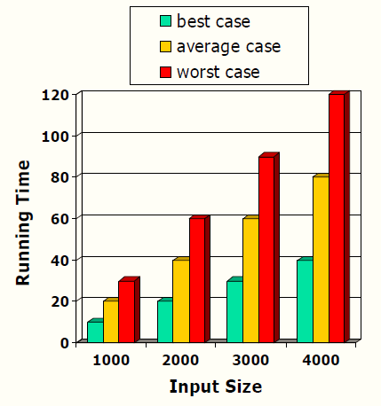
Finding Running Time of an Algorithm
Best case running time is usually not very useful
Average case time is very useful but often hard to determine
Worst case running time is easier to analyze
– Crucial for real-time applications such as games, finance and robotics

Slide 11
Finding Running Time of an Algorithm
Running time is measured by number of steps/primitive operations performed
We use RAM (Random Access Model), in which each operation (e.g. +, -, x, /,=) and each memory access take one run-time unit. Loops and functions can take multiple time units.
Count the number of basic operations of an algorithm
Read, write, compare, assign, jump, arithmetic operations (increment, decrement, add, subtract, multiply, divide), open, close, logical operations (not/complement, AND, OR), …

Slide 12
Experimental Evaluation of Run Time
Write a program implementing the algorithm
Run the program with inputs of varying size
Use clock methods to get an accurate measure of the actual running time
Plot the results
9000
8000
7000
6000
5000
4000
3000
2000
1000
0
Time (ms)
0
50
Input Size
100

Slide 13
Limitations Of Experiments
Experimental evaluation of running time is very useful but
It is necessary to implement the algorithm, which may be difficult
Results may not be indicative of the running time on other inputs not included in the experiment
In order to compare two algorithms, the same hardware and software environments must be used

Slide 14
Theoretical Analysis of Run Time
Uses a pseudo-code description of the algorithm instead of an implementation
Characterizes running time as a function of the input size n
Takes into account all possible inputs
Allows us to evaluate the speed of an algorithm independent of the hardware/software environment

Slide 15
Analyzing an Algorithm – Operations
Each machine instruction is executed in a fixed number of cycles
We may assume each operation requires a fixed number of cycles
Idea: Use abstract machine that uses steps of time instead of secs
Each elementary operation takes 1 steps
Example of operations
Retrieving/storing variables from memory
Variable assignment
Integer operations
Logical operations
Bitwise operations
Relational operations
Memory allocation and deallocation

Slide 16
Analyzing an Algorithm – Blocks of Operations
Each operation runs in a step of 1 time unit
Therefore any fixed number of operations also run in 1 time step
s1; s2; …. ; sk
As long as number of operations k is constant

Slide 17
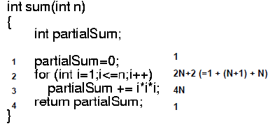
Example
Lines 1 and 4 count for one unit each.
Line 3: executed N times, each time four units.
Line 2: (1 for initialization, N+1 for all tests, N for all increments) total 2N + 2.
total time units: 6N + 4

Slide 18
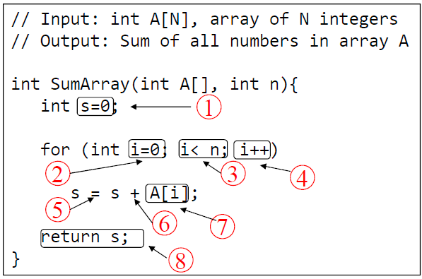
Analyzing an Algorithm
Operations 1,2,8 are executed once
Operations 4,5,6,7: Once per each iteration of for loop n iteration
Operation 3 is executed n+1 times
The complexity function of the algorithm is : T(n) = 5n +4

Slide 19
Analyzing an Algorithm – Growth Rate
Estimated running time for different values of n:
n = 10 => 54 steps
n = 100 => 504 steps
n = 1,000 => 5004 steps
n = 1,000,000 => 5000004 steps
As n grows, number of steps T(n) grow in linear proportion to n

Slide 20
Types of Algorithms in Relation to Time
Linear Algorithm
Takes a time in order of n (n is size of instances)
Quadratic Algorithm
Takes a time in order of n²
Cubic Algorithm
Takes a time in order of n³
Polynomial Algorithm
Takes a time in order of n^{k} (k is constant)
Exponential Algorithm
Takes a time in order of c^{n} (c is constant)

Slide 21
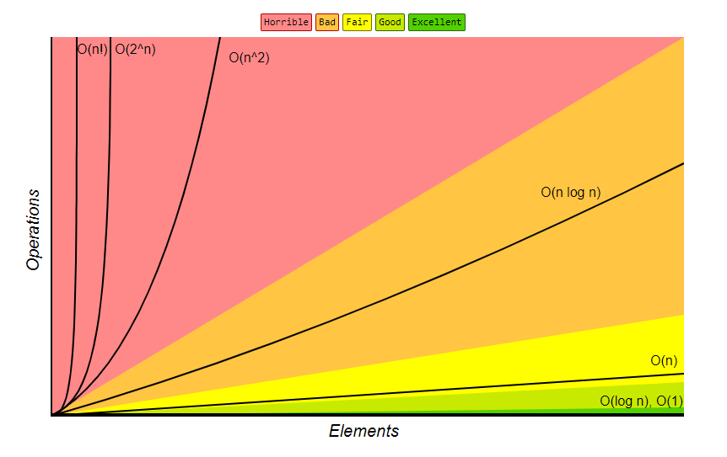

Slide 22
Growth Rate
Changing the hardware/software environment
Affects T(n) by a constant factor, but
Does not alter the growth rate of T(n)
Thus we focus on the big-picture which is the growth rate of an algorithm
The linear growth rate of the running time T(n) is an fundamental property of algorithm sumArray

Slide 23
Constant Factors
The growth rate is not affected by
Constant factors or
Lower-order terms
Examples
10²n + 10⁵ is a linear function
10⁵n² + 10⁸n is a quadratic function

Slide 24
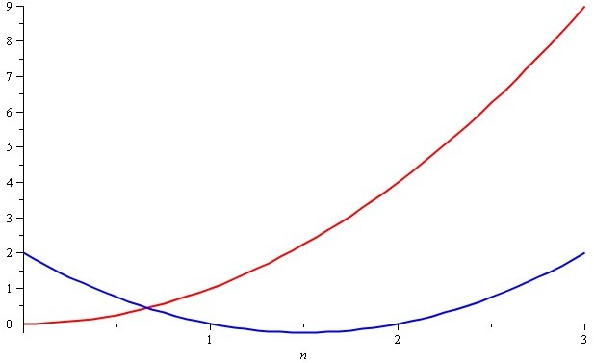
Growth Rate – Example
Consider the two functions
f(n)=n²
g(n)=n²–3n+2
Around n = 0, they look very different

Slide 25
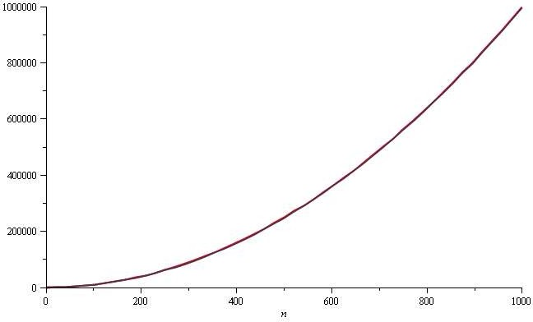
Growth Rate – Example
Yet on the range n = [0, 1000], f(n) and g(n) are (relatively) indistinguishable

Slide 26
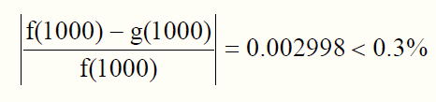
Growth Rate – Example
The absolute difference is large, for example,
f(1000)=1000000
g(1000)=997002
But the relative difference is very small
The difference goes to zero as n → ∞
Notes:
Relative difference compares one value to another. It is helpful in determining the percentage increase or decrease from one value to another.

Slide 27
Constant Factors
How do we get rid of the constant factors to focus on the essential part of the running time?
Asymptotic Analysis

